Slide 1

UWA DATA ANALYSIS BOOTCAMP – PROJECT 3 Data visualization TEAM 5 proposal
Our Team
Johan Snyman
Photo and github Links please
Minh Bui
Our Git Repository
https://github.com/JohanfromEsperance/Project-3-DataVisualization.git
https://data.cityofchicago.org/resource/3rse-fbp6.json?trip_id=0000ee6f-65b4-4da6-bd6b-e2be546ac6f0

Slide 2
Project 3-Data visualization Our team will select, analyze, extract, transform, load a dataset and visualize a dashboard and map for e-scooter usage: which top 10 roads in Chicago has highest e-scooter usage
Data Sources
Review
Inspect
Simulate
E
T
L
V
Exploration and Inspiration
Load
Visualize
Extract
Transform
Locate and download data
https://data.cityofchicago.org/Transportation/E-Scooter-Trips-2020/3rse-fbp6/dataABS –
Use JSON and CSV
Prework, structure, common keys, duplicates and NAN
Verify Data formats
Establish MAP and DASHBOARD formats
Design DASHBOARD
LOAD JSON and MAP
Load .CSV to Python and convert
Check CSV loaded correctly
API endpoints
Wrangling steps
Cleaning – NAN
Filter locations/FORMAT
Align location and usage
Rename headers
Remove columns
Save in SQL
Create and display Busy road map
JSON
LEAFLET
HTML
JAVAscript
Create and display Dashboard
PYTHON
Plotly
Check and Test Website
Load to PYTHON
Load to WEB
Check and test data

Slide 3
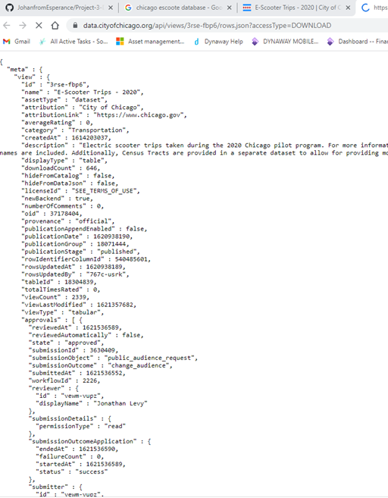
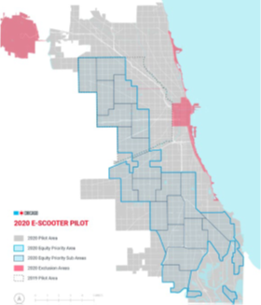
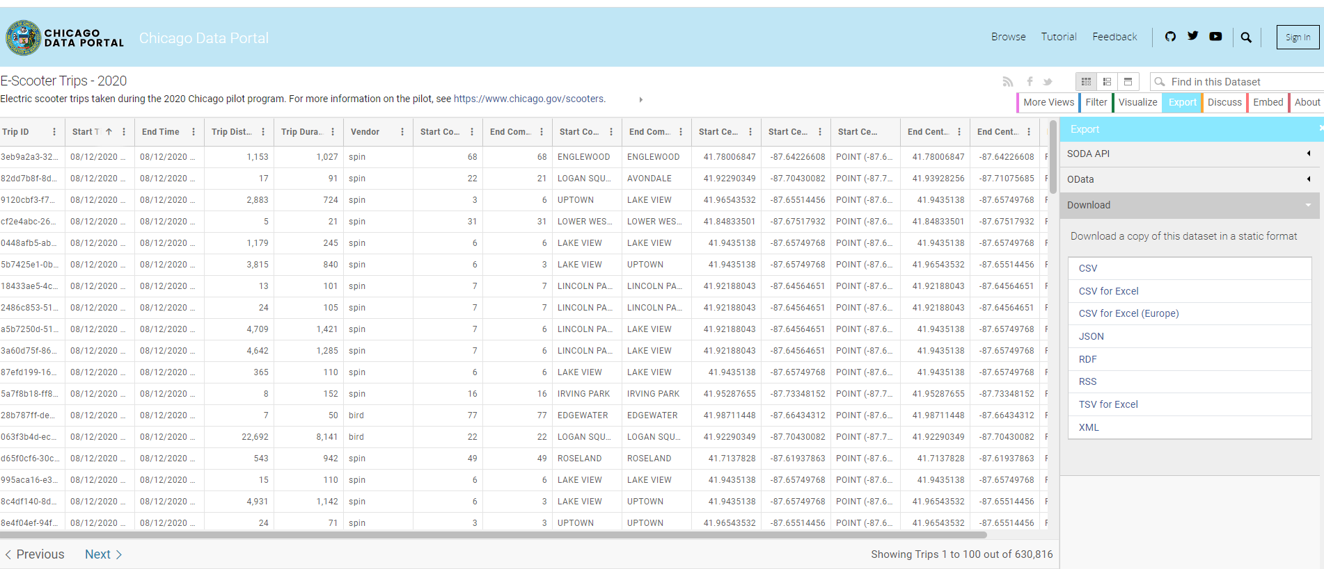
Extract and data sample
Data Sets
Datasets Sourced From - https://data.cityofchicago.org/Transportation/E-Scooter-Trips-2020/3rse-fbp6/data
File A - https://data.cityofchicago.org/Transportation/E-Scooter-Trips-2020/3rse-fbp6/dataABS/JSON
Will limit the design to the first 1000 datapoints
Will filter for the top 10 busiest streets/routes
File B - https://data.cityofchicago.org/Transportation/E-Scooter-Trips-2020/3rse-fbp6/dataABS/CSV
Will limit the design to the first 1000 datapoints
Will filter for the top 10 busiest streets/routes

Slide 4
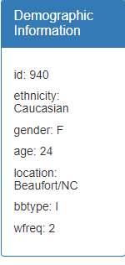
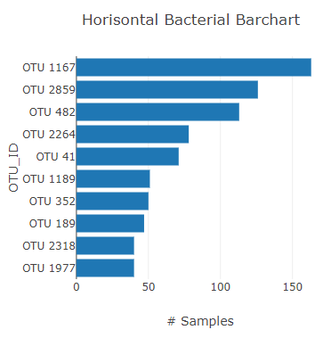

WEB PAGE-Chicago e-scooter road usage
Display via github.io
HEADER
Body/DIV2
Body/DIV5
Body/DIV5
Demographic data for Top 10 Routes
Barchart with Demographic data
MAP
Overlay – SUBBURBS
OVERLAY Markers
HOVER MARKERS – Demographic display

Slide 5
Research and Inspiration
https://www.divvybikes.com/system-data
https://data.cityofchicago.org/Transportation/E-Scooter-Trips-2019-Pilot/2kfw-zvte
https://www.epa.gov/smartgrowth/smart-location-database-technical-documentation-and-user-guide
https://www.chicago.gov/content/dam/city/depts/cdot/Misc/EScooters/E-Scooter_Pilot_Evaluation_2.17.20.pdf.
See discussions, stats, and author profiles for this publication at: https://www.researchgate.net/publication/355140802
Analyzing the Impacts of a Successful Diffusion of Shared E-Scooters
https://doi.org/10.36501/0197-9191/22-006
https://codebeautify.org/jsonviewer
https://dev.socrata.com/foundry/data.cityofchicago.org/3rse-fbp6

